Slide 1
Learning Objective
We will learn about employment and explore a few careers.
Agenda:
1. Announcements
2. Key Terms
3. Explore Careers Learning Activity

Slide 2
This Week’s Announcements
Weds. Sept. 30th- Student Council elections
Tues. Sept. 22^{nd-} Virtual 9th Grade Parent Meeting 6-7 PM
Thurs. Sept. 24th- Virtual 10th Grade Parent Meeting 6-7 PM
Tues. Sept. 29th- Virtual 11th Grade Parent Meeting 6-7 PM

Slide 3
Key Terms
Full-Time- Employment where the work hours are 40 or more per week, usually 8 hours a day, 5 days a week. Examples include: teacher, doctor, city worker, and engineer.
Part-Time- Employment where the work hours are less than 40 per week, usually without benefits. Examples include: waiter/ waitress, barista, lifeguard, and cashier.
Benefits- types of non-monetary payment offered to employees, may include health and dental insurance, retirement, vacation and sick leave.

Slide 4
Key Terms Continued
Interview- A meeting between a job applicant and the hiring employer. It can be face-to-face, over the phone or internet.
Resume- A list of one’s academic and professional achievements, references, and skills. All jobs require an application or resume before being hired. Like a college resume.

Slide 5
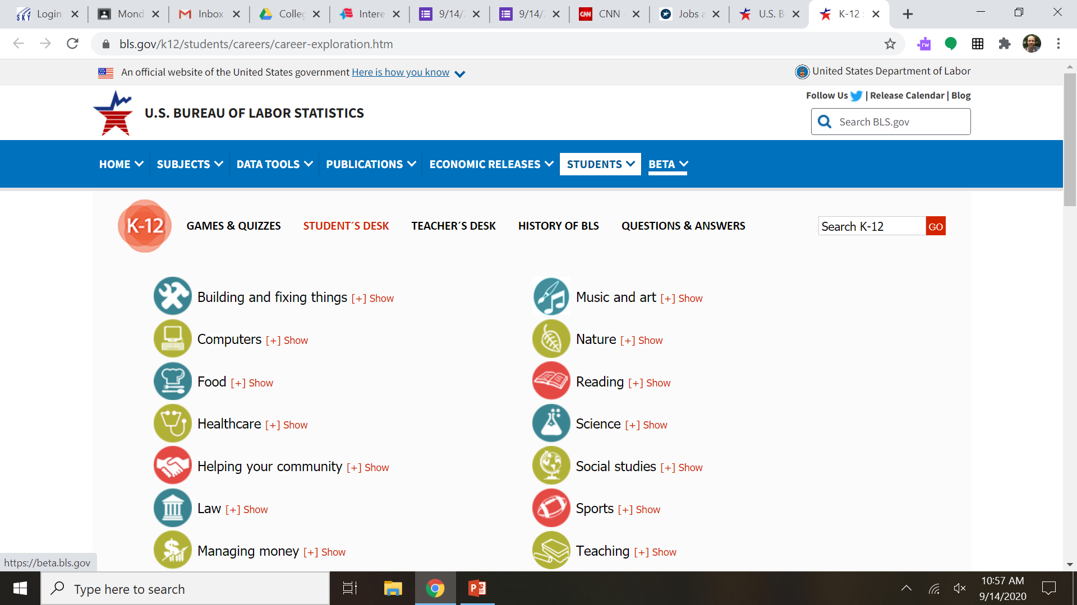
Explore Careers Learning Actvity
Go to https://www.bls.gov/k12/students/careers/career-exploration.htm
Pick One Career and answer the questions on the following slide.

Slide 6

Explore Careers Learning Activity
What does a person do in this career?
What is the median pay for this career?
What level of education is necessary to get a job in this field?
How many people have this job?
List three similar occupations.

